Slide 1
Decision Tree Classification
Tomi Yiu
CS 632 — Advanced Database Systems
April 5, 2001

Slide 2
Papers
Manish Mehta, Rakesh Agrawal, Jorma Rissanen: SLIQ: A Fast Scalable Classifier for Data Mining.
John C. Shafer, Rakesh Agrawal, Manish Mehta: SPRINT: A Scalable Parallel Classifier for Data Mining.
Pedro Domingos, Geoff Hulten: Mining high-speed data streams.

Slide 3
Outline
Classification problem
General decision tree model
Decision tree classifiers
  SLIQ
  SPRINT
  VFDT (Hoeffding Tree Algorithm)

Slide 4
Classification Problem
Given a set of example records
  Each record consists of
    A set of attributes
    A class label
Build an accurate model for each class based on the set of attributes
Use the model to classify future data for which the class labels are unknown

Slide 5
A Training set
Age | Car Type | Risk
23 | Family | High
17 | Sports | High
43 | Sports | High
68 | Family | Low
32 | Truck | Low
20 | Family | High

Slide 6
Classification Models
Neural networks
Statistical models – linear/quadratic discriminants
Decision trees
Genetic models

Slide 7
Why Decision Tree Model?
Relatively fast compared to other classification models
Obtain similar and sometimes better accuracy compared to other models
Simple and easy to understand
Can be converted into simple and easy to understand classification rules

Slide 8
A Decision Tree
Age < 25
Car Type in {sports}
High
High
Low

Slide 9
Decision Tree Classification
A decision tree is created in two phases:
  Tree Building Phase
    Repeatedly partition the training data until all the examples in each partition belong to one class or the partition is sufficiently small
  Tree Pruning Phase
    Remove dependency on statistical noise or variation that may be particular only to the training set

Slide 10
Tree Building Phase
General tree-growth algorithm (binary tree)
Partition(Data S)
If (all points in S are of the same class) then return;
for each attribute A do
evaluate splits on attribute A;
Use best split to partition S into S1 and S2;
Partition(S1);
Partition(S2);

Slide 11
Tree Building Phase (cont.)
The form of the split depends on the type of the attribute
Splits for numeric attributes are of the form A ≤ v, where v is a real number
Splits for categorical attributes are of the form A ∈ S’, where S’ is a subset of all possible values of A

Slide 12
Splitting Index
Alternative splits for an attribute are compared using a splitting index
Examples of splitting index:
  Entropy ( entropy(T) = - Σp_{j} x log₂(p_{j}) )
  Gini Index ( gini(T) = 1 - Σp_{j}² )
  (p_{j} is the relative frequency of class j in T)

Slide 13
The Best Split
Suppose the splitting index is I(), and a split partitions S into S1 and S2
The best split is the split that maximizes the following value:
  I(S) - |S1|/|S| x I(S1) + |S2|/|S| x I(S2)

Slide 14
Tree Pruning Phase
Examine the initial tree built
Choose the subtree with the least estimated error rate
Two approaches for error estimation:
  Use the original training dataset (e.g. cross –validation)
  Use an independent dataset

Slide 15
SLIQ - Overview
Capable of classifying disk-resident datasets
Scalable for large datasets
Use pre-sorting technique to reduce the cost of evaluating numeric attributes
Use a breath-first tree growing strategy
Use an inexpensive tree-pruning algorithm based on the Minimum Description Length (MDL) principle

Slide 16
Data Structure
A list (class list) for the class label
  Each entry has two fields: the class label and a reference to a leaf node of the decision tree
  Memory-resident
A list for each attribute
  Each entry has two fields: the attribute value, an index into the class list
  Written to disk if necessary

Slide 17
An illustration of the Data Structure
Age | Class List Index |  | Car Type | Class List Index |  |  | Class | Leaf
23 | 1 |  | Family | 1 |  | 1 | High | N1
17 | 2 |  | Sports | 2 |  | 2 | High | N1
43 | 3 |  | Sports | 3 |  | 3 | High | N1
68 | 4 |  | Family | 4 |  | 4 | Low | N1
32 | 5 |  | Truck | 5 |  | 5 | Low | N1
20 | 6 |  | Family | 6 |  | 6 | High | N1

Slide 18
Pre-sorting
Sorting of data is required to find the split for numeric attributes
Previous algorithms sort data at every node in the tree
Using the separate list data structure, SLIQ only sort data once at the beginning of the tree building phase

Slide 19
After Pre-sorting
Age | Class List Index |  | Car Type | Class List Index |  |  | Class | Leaf
17 | 2 |  | Family | 1 |  | 1 | High | N1
20 | 6 |  | Sports | 2 |  | 2 | High | N1
23 | 1 |  | Sports | 3 |  | 3 | High | N1
32 | 5 |  | Family | 4 |  | 4 | Low | N1
43 | 3 |  | Truck | 5 |  | 5 | Low | N1
68 | 4 |  | Family | 6 |  | 6 | High | N1

Slide 20
Node Split
SLIQ uses a breath-first tree growing strategy
  In one pass over the data, splits for all the leaves of the current tree can be evaluated
SLIQ uses gini-splitting index to evaluate split
  Frequency distribution of class values in data partitions is required

Slide 21
Class Histogram
A class histogram is used to keep the frequency distribution of class values for each attribute in each leaf node
For numeric attributes, the class histogram is a list of <class, frequency>
For categorical attributes, the class histogram is a list of <attribute value, class, frequency>

Slide 22
Evaluate Split
for each attribute A
traverse attribute list of A
for each value v in the attribute list
find the corresponding class and leaf node
    update the class histogram in the leaf l
    if A is a numeric attribute then
    compute splitting index for test (A≤v) for leaf l
if A is a categorical attribute then
for each leaf of the tree do
find subset of A with the best split

Slide 23
Subsetting for Categorical Attributes
If cardinality of S is less than a threshold
all of the subsets of S are evaluated
else
start an empty subset S’
repeat
adds the element of S to S’ which gives the best split
until there is no improvement

Slide 24
Partition the data
Partition can be done by updating the leaf reference of each entry in the class list
Algorithm:
for each attribute A used in a split
traverse attribute list of A
for each value v in the list
find corresponding class label and leaf l
find the new node, n, to which v belongs by applying the splitting test at l
update the leaf reference to n

Slide 25
Example of Evaluating Splits
Initial Histogram
 | H | L
L | 0 | 0
R | 4 | 2
Age | Index
17 | 2
20 | 6
23 | 1
32 | 5
43 | 3
68 | 4
 | Class | Leaf
1 | High | N1
2 | High | N1
3 | High | N1
4 | Low | N1
5 | Low | N1
6 | High | N1
Evaluate split (age ≤ 17)
 | H | L
L | 1 | 0
R | 3 | 2
Evaluate split (age ≤ 32)
 | H | L
L | 3 | 1
R | 1 | 1

Slide 26
Example of Updating Class List
Age ≤ 23
N1
Age | Index
17 | 2
20 | 6
23 | 1
32 | 5
43 | 3
68 | 4
 | Class | Leaf
1 | High | N2
2 | High | N2
3 | High | N1
4 | Low | N1
5 | Low | N1
6 | High | N2
N2
N3
N3 (New value)

Slide 27
MDL Principle
Given a model, M, and the data, D
MDL principle states that the best model for encoding data is the one that minimizes Cost(M,D) = Cost(D|M) + Cost(M)
  Cost (D|M) is the cost, in number of bits, of encoding the data given a model M
  Cost (M) is the cost of encoding the model M

Slide 28
MDL Pruning Algorithm
The models are the set of trees obtained by pruning the initial decision T
The data is the training set S
The goal is to find the subtree of T that best describes the training set S (i.e. with the minimum cost)
The algorithm evaluates the cost at each decision tree node to determine whether to convert the node into a leaf, prune the left or the right child, or leave the node intact.

Slide 29
Encoding Scheme
Cost(S|T) is defined as the sum of all classification errors
Cost(M) includes
  The cost of describing the tree
    number of bits used to encode each node
  The costs of describing the splits
    For numeric attributes, the cost is 1 bit
    For categorical Attributes, the cost is ln(n_{A}), where n_{A} is the total number of tests of the form A ∈ S’ used

Slide 30
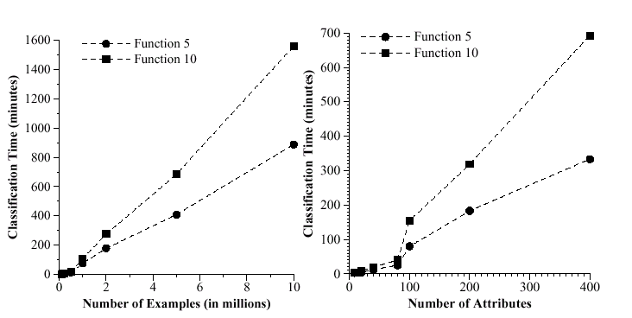
Performance (Scalability)

Slide 31
SPRINT - Overview
A fast, scalable classifier
Use pre-sorting method as in SLIQ
No memory restriction
Easily parallelized
  Allow many processors to work together to build a single consistent model
  The parallel version is also scalable

Slide 32
Data Structure – Attribute List
Each attribute has an attribute list
Each entry of a list has three fields: the attribute value, the class label, and the rid of the record from which these values were obtained
The initial lists are associated with the root
As the node split, the lists will be partitioned and associated with the children
Numeric attributes will be sorted once created
Written to disk if necessary

Slide 33
An Example of Attribute Lists
Age | Class | rid
17 | High | 1
20 | High | 5
23 | High | 0
32 | Low | 4
43 | High | 2
68 | Low | 3
Car Type | Class | rid
family | High | 0
sports | High | 1
sports | High | 2
family | Low | 3
truck | Low | 4
family | high | 5

Slide 34
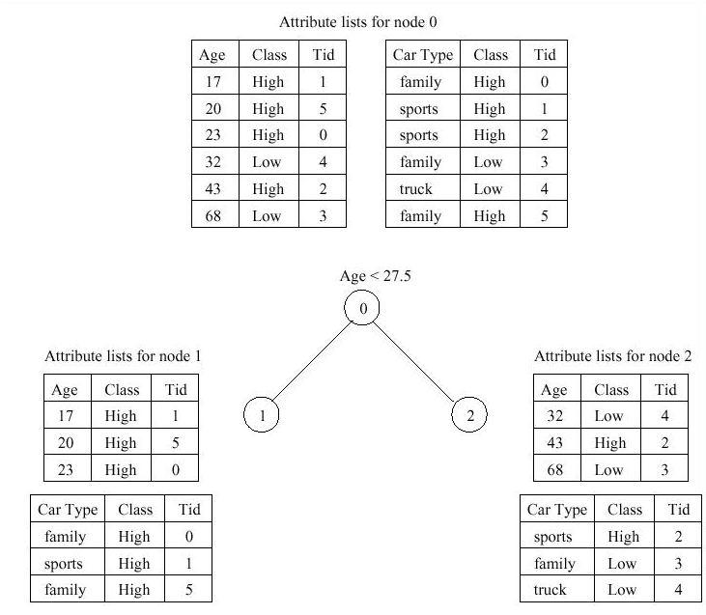
Attribute Lists after Splitting

Slide 35
Data Structure - Histogram
SPRINT uses gini-splitting index
Histograms are used to capture the class distribution of the attribute records at each node
Two histograms for numeric attributes
  C_{below} – maintain data that has been processed
  C_{above} – maintain data that hasn’t been processed
One histogram for categorical attributes, called count matrix

Slide 36
Finding Split Points
Similar to SLIQ except each node has its own attribute lists
Numeric attributes
  C_{below} initials to zeros
  C_{above} initials with the class distribution at that node
  Scan the attribute list to find the best split
Categorical attributes
  Scan the attribute list to build the count matrix
  Use the subsetting algorithm in SLIQ to find the best split

Slide 37
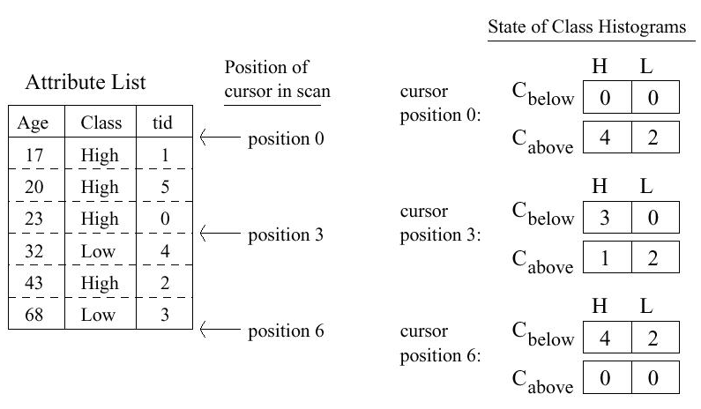
Evaluate numeric attributes

Slide 38
Evaluate categorical attributes
Attribute List
Count Matrix
Car Type | Class | rid
family | High | 0
sports | High | 1
sports | High | 2
family | Low | 3
truck | Low | 4
family | high | 5
 | H | L
family | 2 | 1
sports | 2 | 0
truck | 0 | 1

Slide 39
Performing the Split
Each attribute list will be partitioned into two lists, one for each child
Splitting attribute
  Scan the attribute list, apply the split test, and move records to one of the two new lists
Non-splitting attribute
  Cannot apply the split test on non-splitting attributes
  Use rid to split attribute lists

Slide 40
Performing the Split (cont.)
When partitioning the attribute list of the splitting attribute, insert the rid of each record into a hash table, noting to which child it was moved
Scan the non-splitting attribute lists
  For each record, probe the hash table with the rid to find out which child the record should move to
Problem: What should we do if the hash table is too large for the memory?

Slide 41
Performing the Split (cont.)
Use the following algorithm to partition the attribute lists if the hash table is too big:
Repeat
  The attribute list of the splitting attribute list is partitioned up to the record for which the hash table will fit in the memory
  Scan the attribute list of non-splitting attributes to partition the records whose rids are in the hash table
Until all the records have been partitioned

Slide 42
Parallelizing Classification
SPRINT was designed for parallel classification
Fast and scalable
Similar to the serial version of SPRINT
Each processor has a portion (same size as others) of each attribute lists
  For numeric attribute, sort the attributes and partition it into contiguous sorted sections
  For categorical attribute, no processing is required and simply partition it based on rid

Slide 43
Parallel Data Placement
Process 0
Age | Class | rid
17 | High | 1
20 | High | 5
23 | High | 0
Car Type | Class | rid
family | High | 0
sports | High | 1
sports | High | 2
Process 1
Age | Class | rid
32 | Low | 4
43 | High | 2
68 | Low | 3
Car Type | Class | rid
family | Low | 3
truck | Low | 4
family | high | 5

Slide 44
Finding Split Points
For numeric attribute
  Each processor has a contiguous section of the list
  Initialize C_{below} and C_{above} to reflect that some data are in the other processors
  Each processor scans its list to find its best split
  Processors communicate to determine the best split
For categorical attribute
  Each processor builds the count matrix
  A coordinator collect all the count matrices
  Sum up all counts and find the best split

Slide 45
Example of Histograms in Parallel Classification
Process 0
Age | Class | rid
17 | High | 1
20 | High | 5
23 | High | 0
 | H | L
C_{below} | 0 | 0
C_{above} | 4 | 2
Process 1
Age | Class | rid
32 | Low | 4
43 | High | 2
68 | Low | 3
 | H | L
C_{below} | 3 | 0
C_{above} | 1 | 2

Slide 46
Performing the Splits
Almost identical to the serial version
Except the processor needs <rids, child> information from other processors
After getting information about all rids from other processors, it can build a hash table and partition the attribute lists

Slide 47
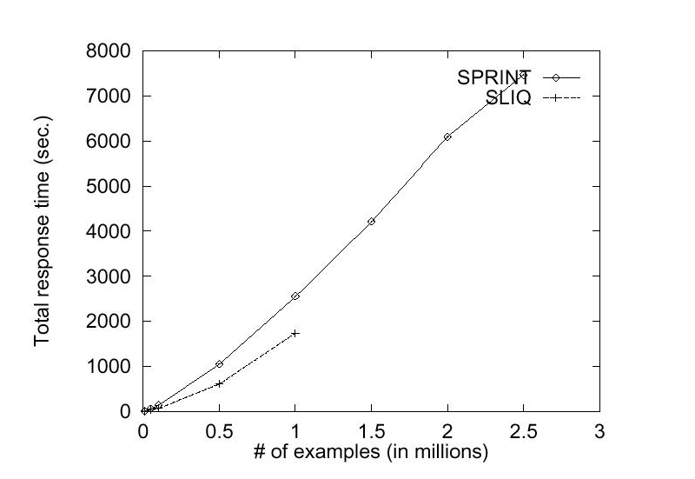
SLIQ vs. SPRINT
SLIQ has a faster response time
SPRINT can handle larger datasets

Slide 48
Data Streams
Data arrive continuously (it’s possible that they come in very fast)
Data size is extremely large, potentially infinite
Couldn’t possibly store all the data

Slide 49
Issues
Disk/Memory-resident algorithms require the data to be in the disk/memory
They may need to scan the data multiple times
Need algorithms that read data only once, and only require a small amount of time to process it
Incremental learning method

Slide 50
Incremental learning methods
Previous incremental learning methods
  Some are efficient, but do not produce accurate model
  Some produce accurate model, but very inefficient
Algorithm that is efficient and produces accurate model
Hoeffding Tree Algorithm

Slide 51
Hoeffding Tree Algorithm
Sufficient to consider only a small subset of the training examples that pass through that node to find the best split
For example, use the first few examples to choose the split at the root
Problem: How many examples are necessary?
Hoeffding Bound!

Slide 52
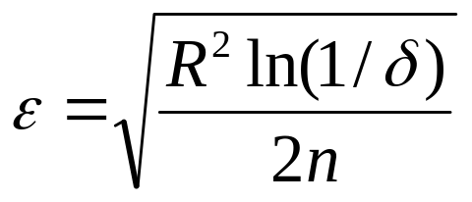
Hoeffding Bound
Independent of the probability distribution generating the observations
A real-valued random variable r whose range is R
n independent observations of r with mean r
Hoeffding bound states that P(μ_{r} ≥ r - ε) = 1 - δ, where μ_{r} is the true mean, δ is a small number, and

Slide 53
Hoeffding Bound (cont.)
Let G(X_{i}) be the heuristic measure used to choose the split, where X_{i} is a discrete attribute
Let X_{a}, X_{b} be the attribute with the highest and second-highest observed G() after seeing n examples respectively
Let ΔG = G(X_{a}) – G(X_{b}) ≥ 0

Slide 54
Hoeffding Bound (cont.)
Given a desired δ, if ΔG > ε, the Hoeffding bound states that P(μ_{ΔG} ≥ ΔG - ε > 0) = 1 - δ
μ_{ΔG} > 0 ⇒ μ_{G(Xa)} - μ_{G(Xb)} > 0 ⇒ μ_{G(Xa)} > μ_{G(Xb)}
X_{a} is the best attribute to split with probability 1- δ

Slide 55
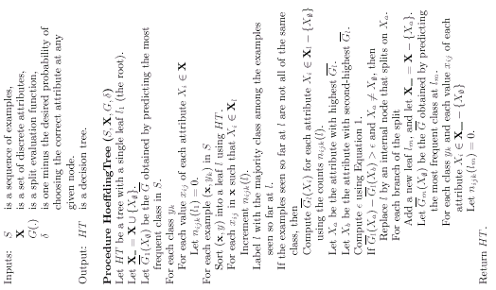

Slide 56
VFDT (Very Fast Decision Tree learner)
Designed for mining data stream
A learning system based on hoeffding tree algorithm
Refinements
  Ties
  Computation of G()
  Memory
  Poor attributes
  Initialization

Slide 57
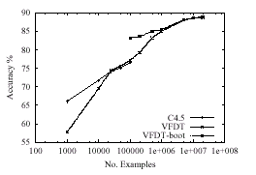
Performance – Examples

Slide 58
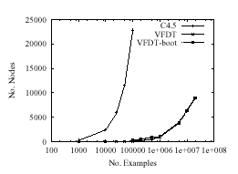
Performance – Nodes

Slide 59
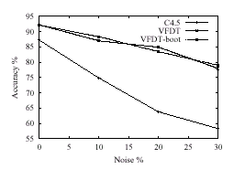
Performance – Noise data

Slide 60
Conclusion
Three decision tree classifiers
  SLIQ
  SPRINT
  VFDT

